Slide 1
Models you can count on
Mieke Abels
mieke@fi.uu.nl

Slide 2
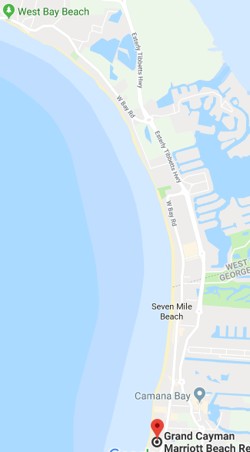
7 Mile beach …
Usually, I walk about 5 kilometer per hour. On the beach, I assume I will walk about 3,5 kilometer per hour.
How much time will it take me to walk that 7 miles (and back?)
Notes:
7 mi == 11,3 m

Slide 3
Models you can count on
Ratio table
Fraction bar
Percent bar
Empty number line
Double number line

Slide 4
Models you can count on
Operations with fractions, decimals, and percents starting at an informal level, supported by models
Relationships between fractions, decimals, and percents

Slide 5
X 10
halving
X 10
subtracting
X 10
adding
Notes:
The operations that students can use are made explicit: adding, times 10, doubling, subtracting, multiplying, and halving.

Slide 6
The ratio table
The operations that students can use are made explicit: doubling, halving times 10, divided by 10 multiplying dividing, adding, subtracting

Slide 7
All the operations that students use in a ratio table, they can also use for:
the fraction bar
percent bar
the double number line

Slide 8
Percent bar

Slide 9
Percent bar
This model enables the use of relationships between absolute numbers (… minutes, liters), percentages (…%), and fractions.

Slide 10
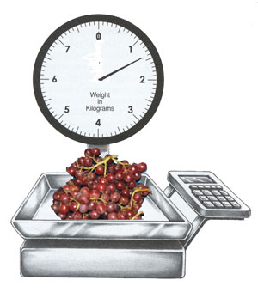
A double number line
The sale price for
grapes is $1.89
per kilogram.

Slide 11
Double number line or ratio table
Notes:
What is the same, what is different?

Slide 12
Mathematizing
Working on the problem
within the mathematical world.
Mathematical objects,
structures, methods
Vertical
mathematizing
Abstract
7 Mile Beach
Translate
‘Realistic’ context
Mathematical model
Horizontal mathematizing
Notes:
Thus the process of mathematization plays out in two different phases. The first is horizontal mathematization, the process of going from the real world to the mathematical world. The second, vertical mathematization is working on the problem within the mathematical world (developing mathematical tools in order to solve the problem). Reflecting on the solution with respect to the original problem is an essential step in the process of mathematization that quite often does not receive proper attention.

