Slide 1
RME and Maths Recovery
A Symbiotic Relationship?
RME6 Maggie Landers

Slide 2
Why????????????
Story to tell
Journey: Classroom Teacher Ireland ▷ Classroom Teacher Grand Cayman (Spoiler Alert)
Values, Attitudes and Beliefs
Numeracy Specialist
▷ Classroom Teacher Grand Cayman
Maths Recovery
▷ Classroom Teacher Grand Cayman
RME - David Webb- M.A. of Education : Curriculum and Instruction, University of Colorado, Boulder
▷ Numeracy Coach ▷ Classroom Teacher Ireland

Slide 4
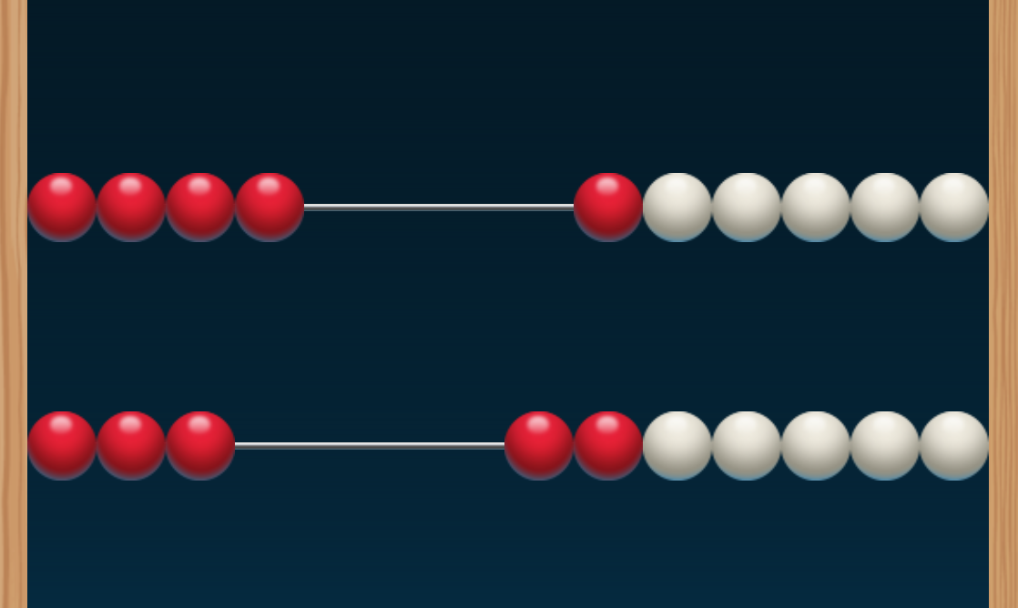

Slide 5
4+3=

Slide 6
Maths Recovery
What is it?
My goal is not to indoctrinate you in Maths Recovery
In a nutshell (simplistic view)
Intervention for students who have gaps in learning
It is a series a diagnostic interview schedules which enables teachers to gain an insight into a child’s mathematical understanding and strategies
It focuses on teachers having an understanding of where students are in their learning and how to elicit, support and extend this learning
It does not suggest that students’ learning is linear nor isolated building blocks which are built upon. Oops!

Slide 7
Effective Teaching of Mathematics
Guiding Principles Maths Recovery
Inquiry Based/ Problem Based
Assessment is USED to inform orchestration of learning
Zone of Proximal Development
Learning Experiences are selected purposefully
Knowledge of child’s current strategies is used to engender more sophisticated strategies
Fine-tuning
Supports and builds on the child’s intuitive, verbally based strategies moving towards written forms of arithmetic
Time to solve problems
Intrinsic satisfaction
Guiding Principles RME
Activity Principle
Reality Principle
Level Principle
Intertwinement principle
Interactivity
Guidance

Slide 8
Videos
Video 1 & 2:
Same Assessment Task
Think about what the child is doing
Compare strategies
What would you do with this information?
Video 3:
Think about what the child is doing
How is this helpful?
Anticipate what another child might do
Notes:
Video 2:21/ Video 2 2:03

Slide 9
Back to the Classroom

Slide 10
Addition and Subtraction
Anticipated Student Solution Strategies
Anticipated Student Misconceptions
Numbers
Formal
+ - =
Progressive Formalization
Progressive Schematization
Where to next?
Pre-Formal
Informal
Notes:
13:46
Video 1: 2:26
Video 2: 2:05

Slide 11
Research Lesson
Making sense of
composition of Teen Numbers
Addition and Subtraction
Making sense of student strategies
Using student strategies to support
and extend the strategies of others

Slide 12
Making Sense of The Landscape of Learning

Slide 13
Questions/ Comments

